Slide 1
Group 19
Smoker Status Analysis
using Bio-Signals
Zhiyang Zhang, Unay Shah, Pin-Ying Wu, Zoom Chow
Notes:
Hello everyone, we are group 19, and our project aims to analyze smoker status using bio-signals.

Slide 2
Outline
Task Description
Dataset Introduction
Data Analysis and Visualization
Top-influential Bio-factors
Conclusions
Reference
Q & A
Notes:
Here is our presentation outline. First, we will introduce our task and the dataset we used; then, we will show some visualization of our dataset, introduce our methods to analyze the data, find the top influential bio-factors we found, and finally, the conclusions and QA time.

Slide 3
Task Description
Smoking ranks as a primary factor in preventable diseases and fatalities globally, with negative impacts across multiple health aspects.
Despite evidence-based treatments, smoking cessation rates remain low, partly due to perceived inefficacy and time constraints found in physician counseling.
There's a critical need for physicians to effectively identify smokers who are more likely to quit. The proposed solution involves mathematical analysis of datasets to pinpoint influential bio-signals for smoker identification.
Notes:
Smoking has been extensively demonstrated to have detrimental effects on health across various dimensions. As of 2018, it stands as the primary contributor to avoidable illness and death worldwide, persistently undermining global health. While evidence-based treatments for smoking cessation have been advocated and promoted, fewer than one-third of participants managed to attain abstinence. Many physicians perceive counseling for smoking cessation as ineffective and time-consuming, leading them to omit it from their daily practice routine. Therefore, there comes an urgent need for doctors to have a method to identify smokers who have a better chance of quitting. Our proposed solution is mathematically analyzing all the factors in datasets and finding top-influential bio-signals to identify smokers and nonsmokers.

Slide 4
Dataset Introduction
ML Olympiad Dataset ^{[1]} contains training and testing CSV files with 23 bio-signal features per patient.
Numerical features: age, height, weight, waist, eyesight (left & right), systolic, relaxation, fasting blood sugar, cholesterol, triglyceride, HDL, LDL, hemoglobin, serum creatinine, AST, ALT, Gtp
Categorical features: hearing (left & right), urine protein, dental caries
Target prediction: smoking status
We focus on the data analysis and visualization, so we only use the training data.
Notes:
We use ML Olympiad Dataset, which contains training and testing CSV files with 23 bio-signal features per patient. For example, there are numerical features, including age, height, weight, waist, eyesight, and so on, to reflect the patient's health condition. Also, there are categorical features, like hearing, urine protein, and dental caries, to classify the patients. And our target is the smoking status. We only use training data because we focus on data analysis and visualization.

Slide 5
Data Analysis and Visualization
Notes:
Here, we show our data analysis and visualization.

Slide 6
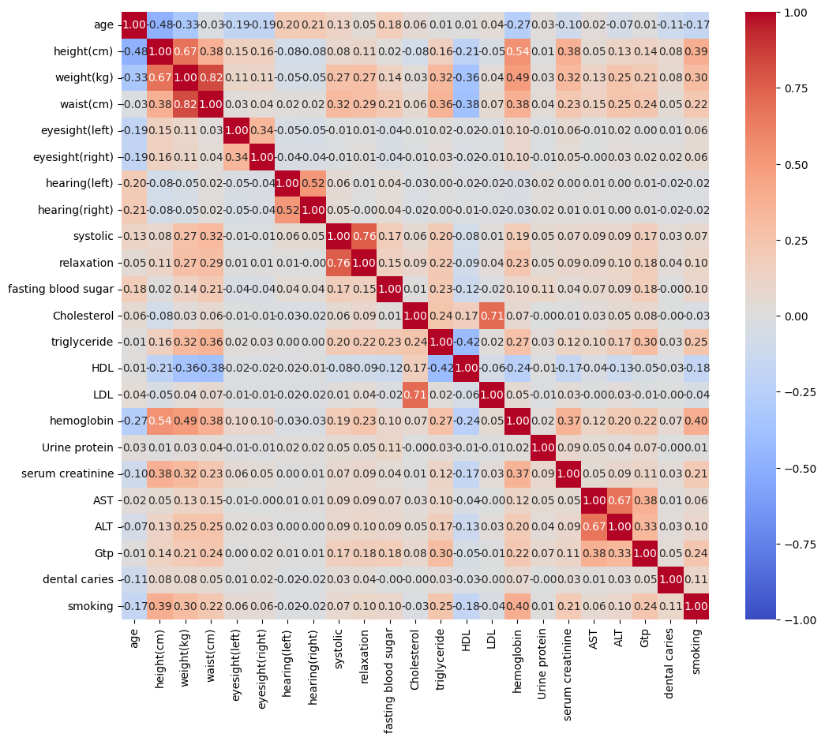
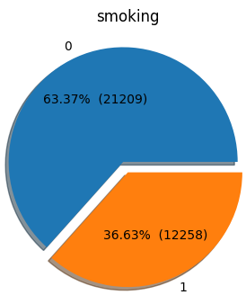
Relationship between Different Features
Many possible features, some more distinctive than others
Notes:
According to the data statistics, there are about 63% smokers and 37% nonsmokers. From the heatmap on the right, we can see that there are many possible features, some more distinctive than others. The more red, the higher the correlation. We can see in the bottom row, which is the smoking status, it seems that the hemoglobin levels, triglyceride levels, height and weight are more related to the smoking status.

Slide 7
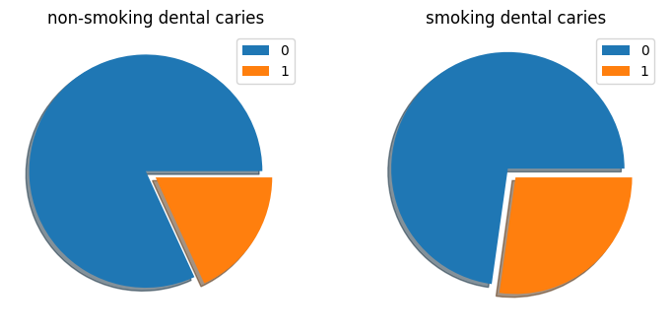
Pie Chart of Categorical Features
Dental caries are more commonly known as tooth decay/cavities
Less dental caries in non-smokers than those who smoke
Notes:
We also show the pie chart of categorical features. Dental caries are more commonly known as tooth cavities. From the pie chart, we can see fewer dental caries among nonsmokers than among those who smoke.

Slide 8
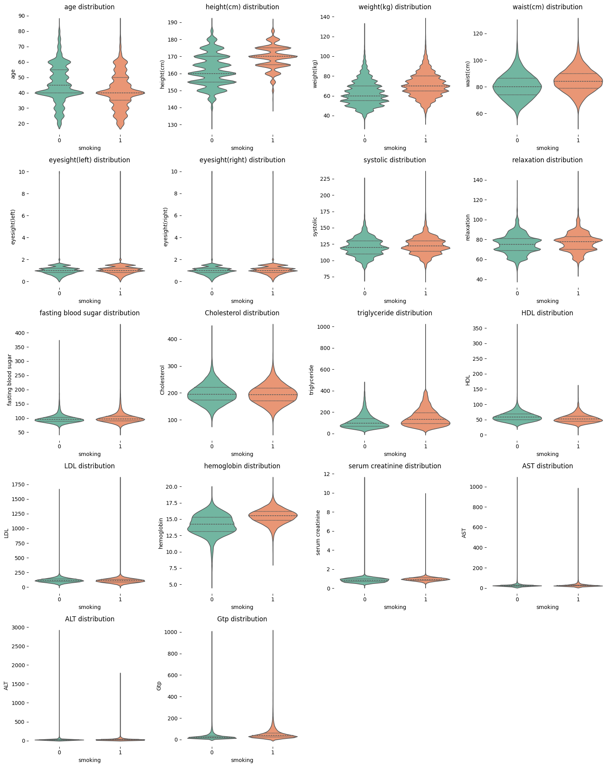
Violin Chart of Numerical Features
Larger hemoglobin and triglyceride distribution in those who smoke
Larger weight/height in those who smoke could suggest higher proportion of male smokers
Notes:
From the violin chart of numerical features, we can observe that smokers have a larger hemoglobin and triglyceride distribution and a larger weight and height, which could suggest a higher proportion of male smokers.

Slide 9
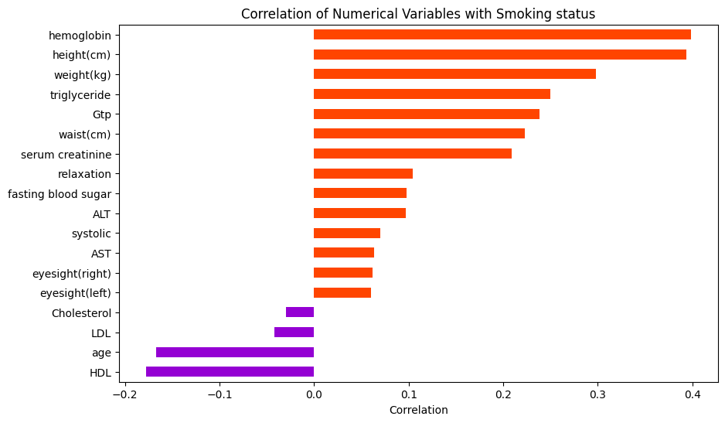
Correlation of Numerical Variables with Smoking
Notes:
We also plot the correlation of numerical variables with smoking. We can see that there is a high correlation between smoking and hemoglobin levels, triglyceride levels, height, and weight, as we previously mentioned, and cholesterol, age, and so on have a negative correlation to smoking status.

Slide 10
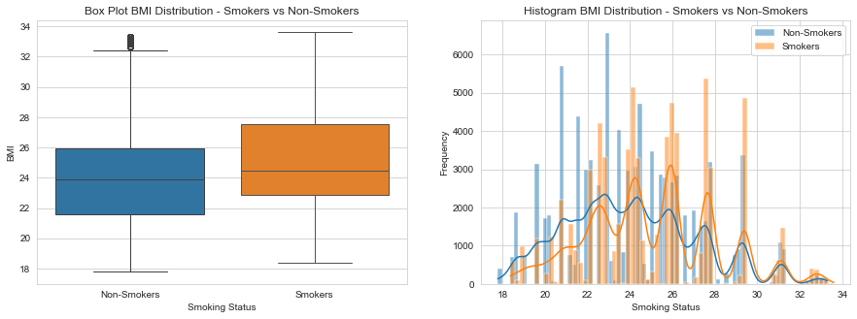
BMI Analysis
Notes:
When looking into the BMI histogram distribution depicted on the right, there appears to be a prevailing pattern of decreasing weight, thus resulting in a decrease in BMI. However, it's noteworthy that we have identified an increase in BMI contrary to this trend. Our hypothesis for this anomaly is that individuals with higher body weights may be more inclined to smoke frequently, potentially indicating an unhealthy lifestyle.

Slide 11
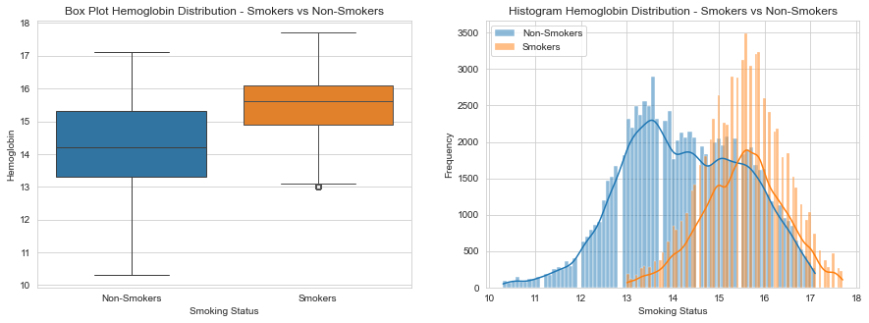
Blood Analysis
Hemoglobin of smokers tends to spike ^{[2]}
Notes:
We also analyze the patients' blood conditions in box plots and histograms. Smokers' hemoglobin tends to spike due to the less efficient delivery of oxygen.

Slide 12
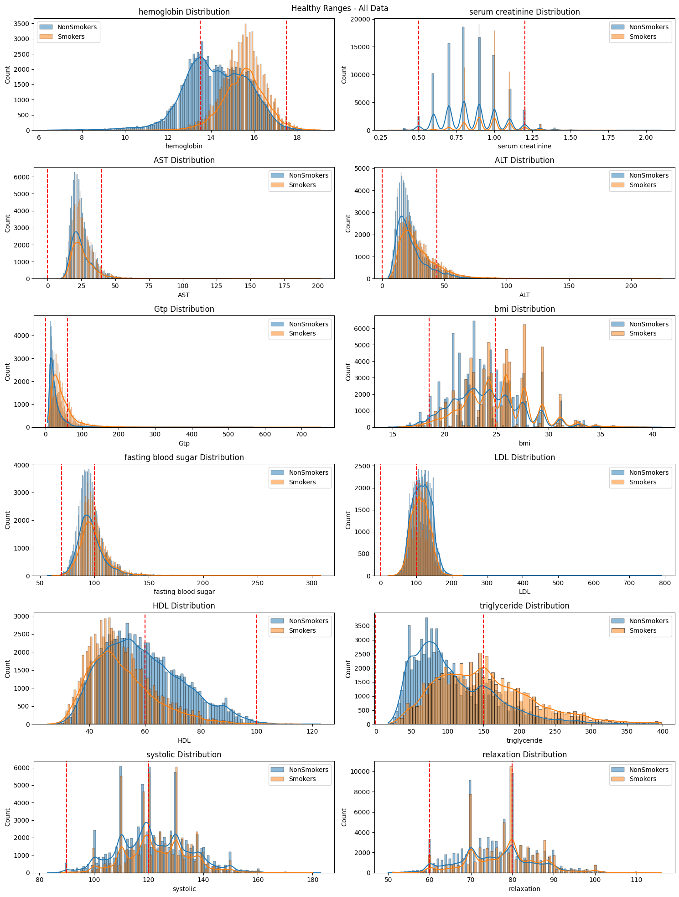
Health Features
Much higher Triglyceride Levels | Much higher ALT Levels
Much lower HDL Levels | Much higher Guanosine-5'-triphosphate (GTP) Levels
Notes:
To further analyze health features, we plot the distribution of smokers and nonsmokers in triglycerides, ALT, HDL, and ATP. Triglycerides serve as an indicator of fats that are not utilized as calories[6]. Alanine aminotransferase (ALT), an enzyme predominantly present in the liver and kidney, exhibits elevated levels in cases of liver damage, making it a vital marker for screening and monitoring liver disease[5]. Guanosine-5'-triphosphate (GTP) is a crucial component in RNA synthesis during transcription. However, an excessive accumulation of GTP levels beyond a certain threshold can impede growth, indicating a potential toxic effect[7]. All of these factors reflect the difference between smokers and nonsmokers. The blue line is nonsmokers, and the orange line is smokers. As we can see in these four figures, nonsmokers are generally healthier than smokers since smoking can have detrimental effects on both liver and kidney health. It is associated with an increased risk of various liver diseases, such as fatty liver, cirrhosis, and liver cancer. The toxins present in cigarette smoke can elevate oxidative stress in the liver, exacerbating inflammation and damage, thereby compromising liver function. Additionally, smoking is linked to kidney diseases, including chronic kidney disease (CKD) and kidney cancer.

Slide 13
Top-influential Bio-factors
The most distinctive and helpful bio-factors to aid physicians include:
Hemoglobin levels
Triglyceride levels
BMI
Study shows that obese people are at higher risk of smoking. ^{[4]}
However, there is an inverse relationship between BMI and smoking ^{[3]}
Smokers with higher BMI consume more cigarettes per day and might be more nicotine-dependent than lean smokers.
⇒ There is a bi-directional relationship between BMI and smoking.
Notes:
Therefore, from our analysis, the most distinctive and helpful bio-factors to aid physicians include hemoglobin levels, triglyceride levels, and BMI. We found that a study shows that obese people are at higher risk of smoking. However, there is an inverse relationship between BMI and smoking. Smokers with higher BMI consume more cigarettes per day and might be more nicotine-dependent than lean smokers. So, we think there is a bidirectional relationship between BMI and smoking.

Slide 14
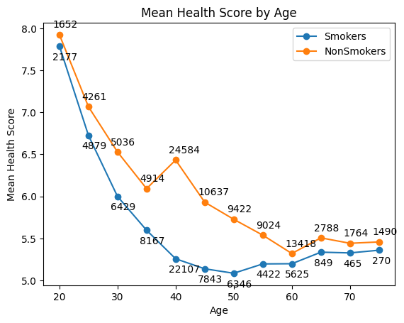
Calculating a Health Score
A health score is calculated using the following features and ranges:
Hemoglobin: 13.5 - 17.5
Serum creatinine: 0.5 - 1.2
AST: 0 - 40,
ALT: 0 - 44,
Gtp: 0 - 60,
BMI: 18.5 - 24.9
Fasting blood sugar: 70 - 100
LDL: 0 - 100
Total cholesterol: 0 - 200
Triglyceride: 0 - 150
Systolic: 90 - 120
Relaxation: 60 - 80
Number indicates count of samples used to calculate mean
Notes:
From the plot, we can observe that the mean health score of non-smokers is obviously higher than that of smokers through all different age groups which indicates that smoking does have significant negative impacts on health.

Slide 15
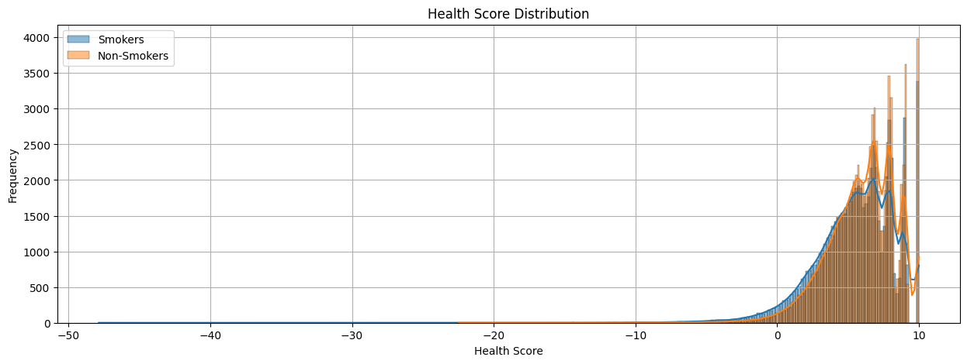
Health Score for Entire Dataset
Smokers: Mean: 5.512, Min: -47.866 | Non-Smokers: Mean: 6.015, Min: -22.487

Slide 16
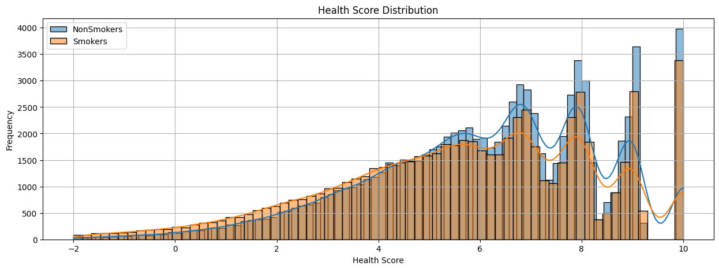
Health Score for Entire Dataset

Slide 17
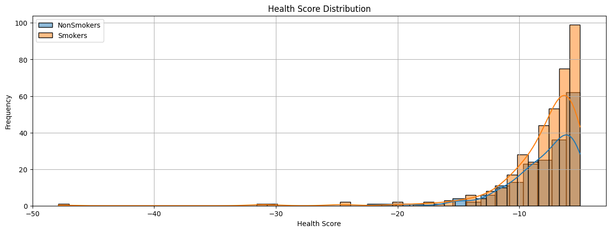
Health Score for Entire Dataset

Slide 18
Conclusion
From the health score distribution plot, it is evident that there is a larger number of smokers in the lower range, and their average health score is lower compared to non-smokers. Additionally, many smokers have a health score less than -2, indicating significant harm to health due to smoking.
Health score reduces as age increases, but the health score of smokers is consistently lower than that of non-smokers.
Notes:
As we can see in the previous health score distribution plot, a considerable proportion of smokers fall within the lower range of health scores, with their average health score being notably lower than that of nonsmokers. Furthermore, a substantial number of smokers exhibit a health score below -2, indicating considerable harm to health attributed to smoking. Also, the health score reduces as age increases, but the health score of smokers is consistently lower than that of nonsmokers.

Slide 19
Reference
[1] ML Olympiad Dataset (https://www.kaggle.com/competitions/ml-olympiad-smoking/data)
[2] Tobacco smoking causes secondary polycythemia and a mild leukocytosis among heavy smokers in Taif City in Saudi Arabia. [Alkhedaide, A. Q. (2020). In Saudi Journal of Biological Sciences, 27(1), 407-411.]
[3] Obese Smokers as a Potential Subpopulation of Risk in Tobacco Reduction Policy. [Rupprecht LE, Donny EC, Sved AF. ]. In Yale J Biol Med. 2015 Sep 3;88(3):289-94]
[4] New evidence on link between obesity and smoking behaviour from genetic data: obese people at higher risk of smoking. (https://www.bristol.ac.uk/news/2018/may/obesitysmoking.html)
[5] Alanine Aminotransferase (https://emedicine.medscape.com/article/2087247-overview)
[6] Triglycerides: Why do they matter? (https://www.mayoclinic.org/diseases-conditions/high-blood-cholesterol/in-depth/triglycerides/art-20048186)
[7] Lowering GTP Level Increases Survival of Amino Acid Starvation but Slows Growth Rate for Bacillus subtilis Cells Lacking (p)ppGpp [Bittner AN, Kriel A, Wang JD 2014 Jun;196(11):2067-76. doi: 10.1128/JB.01471-14]
Notes:
Here are our reference.

Slide 20
Thanks for listening!
Any questions?
Notes:
Thanks for your listening! Do you have any questions?

